Slide 1
Ω
Notes:
Have you ever spent hours on a great lesson with the perfect examples and eloquent proofs, then you give a seamless delivery to the class, and the first student you talk to says “So… how do we do this?”

Slide 2
Been There Before?
Ω
Notes:
I’m sure none of us have felt like this teacher before.

Slide 3
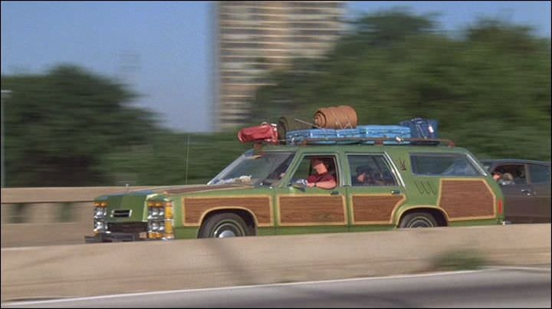
So, how do we learn?
Ω
Notes:
I remember driving to grandma’s house in the old station wagon. As a kid in the back seat, we ended up at grandma’s house, but had no idea how I got there. When I got to finally ride in the front seat, I understood how we took the freeway to Birmingham exit, by the Carl’s Jr. and make my way to Grandma’s.
But it wasn’t until I got the keys and tried to get there on my own, after backtracking a few times I finally remembered how to get there.

Slide 4
“I hear and I forget…
… I see and I understand…
…I do and I remember.”
Ω
Notes:
As the Chinese proverb says
“I hear and I forget
I see and I understand
I do and I remember.”

Slide 5
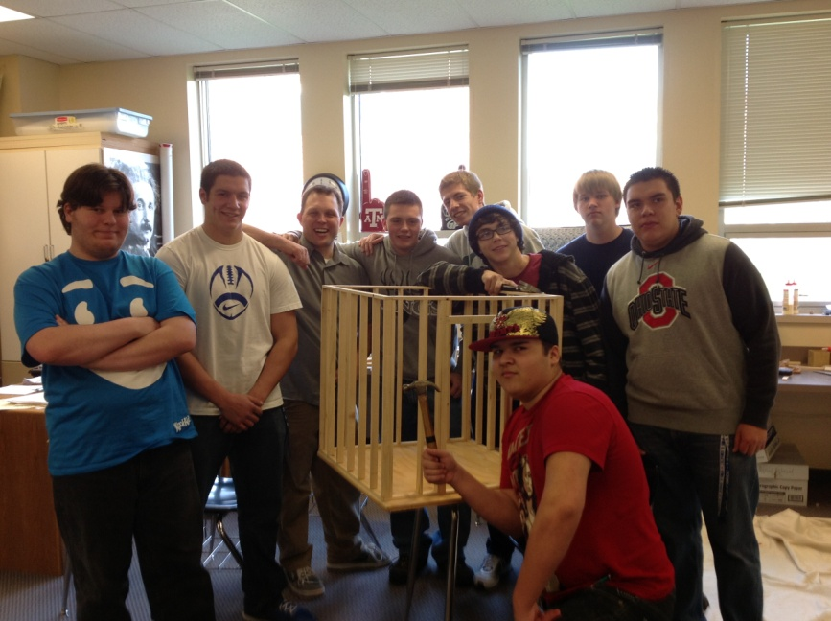
Get them in the driver seat.
“ Real life” application
Ω
Notes:
We need to get students into the driver’s seat.
We can talk about how a contractor might use math, but what if we have kids try to build something for themselves? Let the task convince them they need the math.

Slide 6
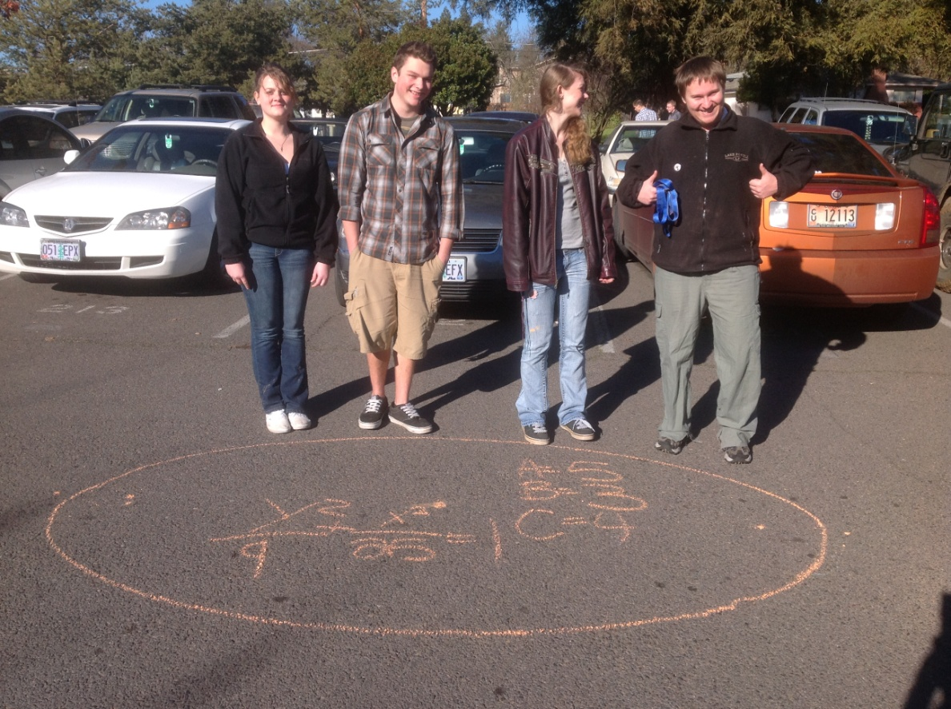
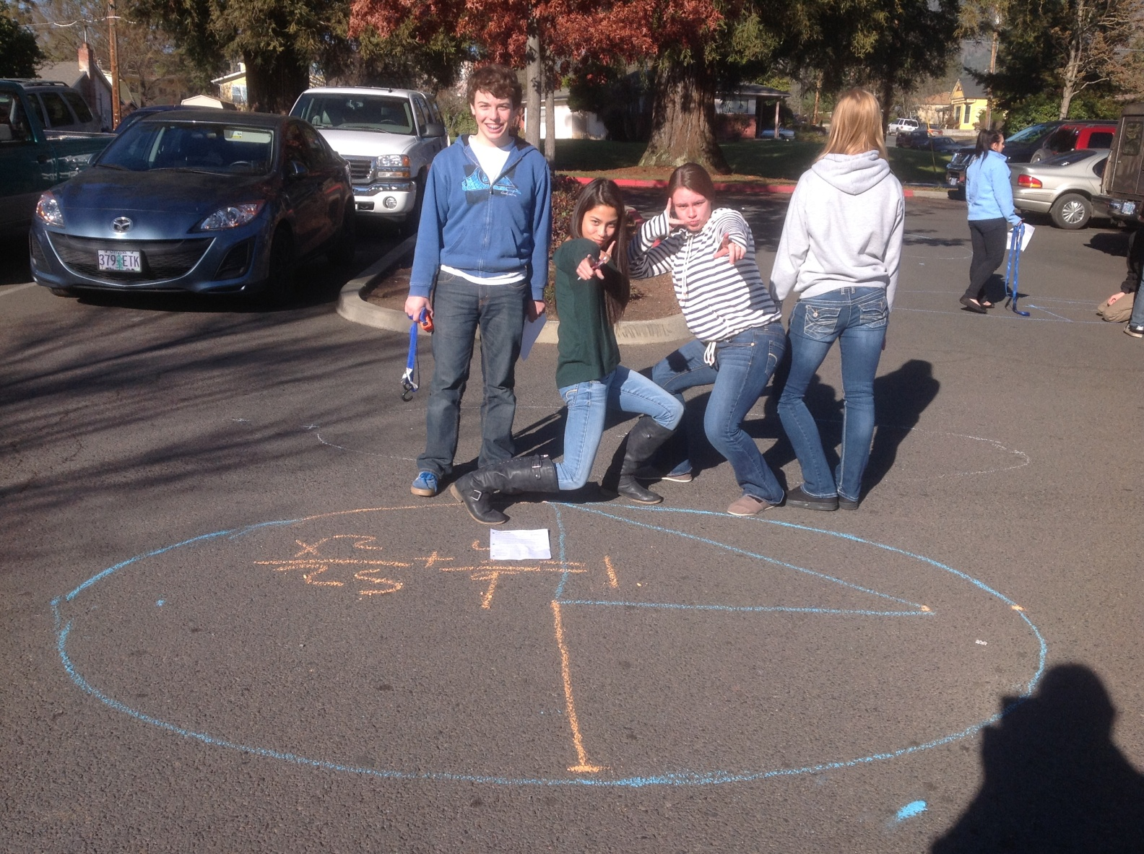
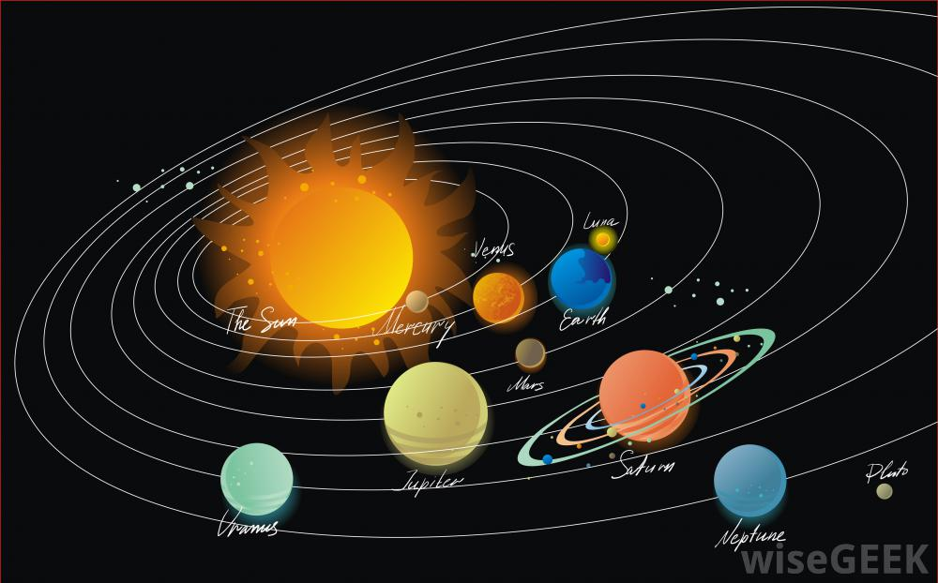
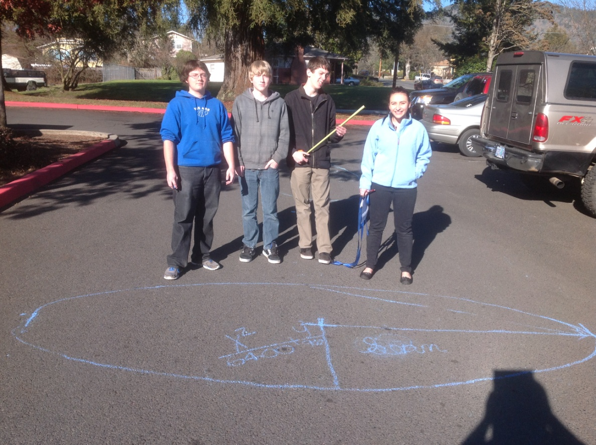
“Right Now” application
Ω
Notes:
We can talk about planets that have an elliptical orbit and do a dozen problems about planets that most students will never see, or go design an ellipse of our own… and have fun doing it.

Slide 7
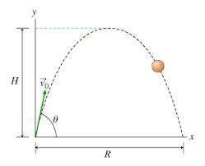
Reaching Max. Velocity
Option 1:
Find the height of a ball with initial velocity of
20 fps
30 fps
200 in/sec
5 mph
10 i.d.k.
Option 2: Get your own data
Ω

Slide 8
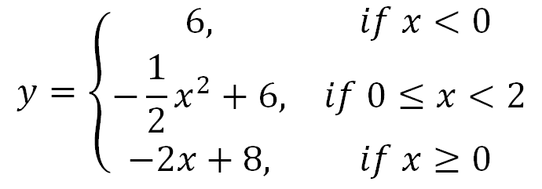
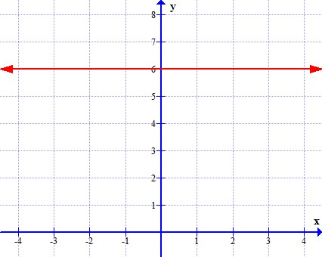
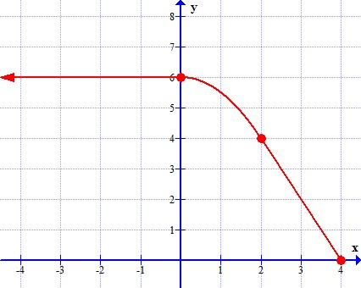
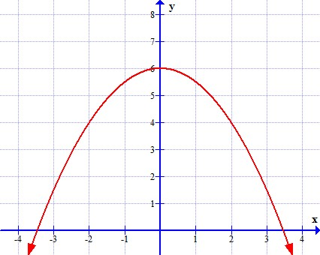
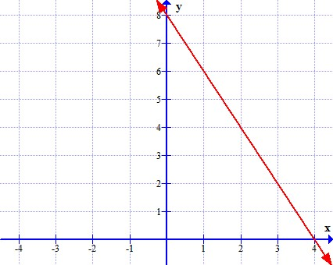
So Many Pieces
Ω

Slide 9
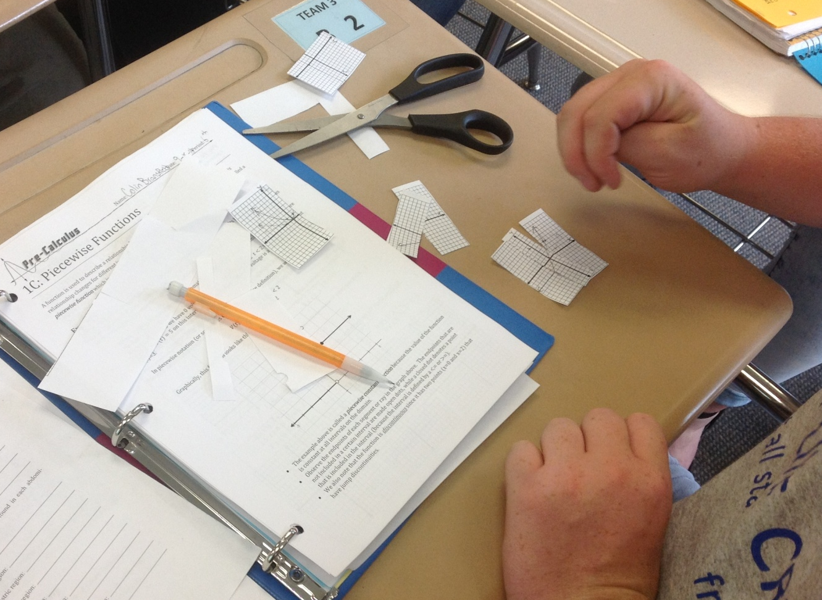
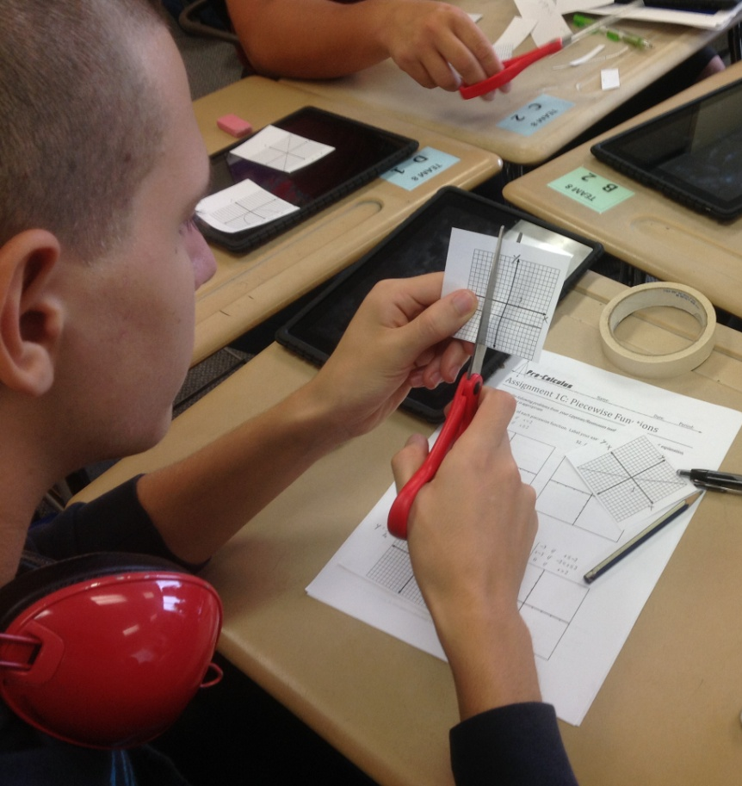
Cut it Up!
Ω

Slide 10
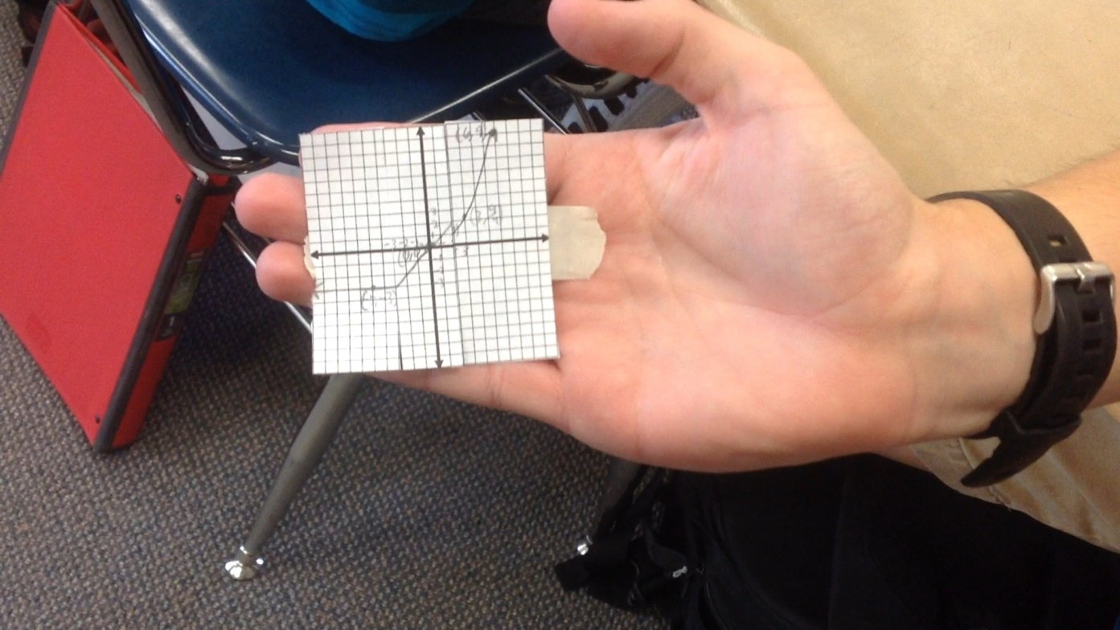
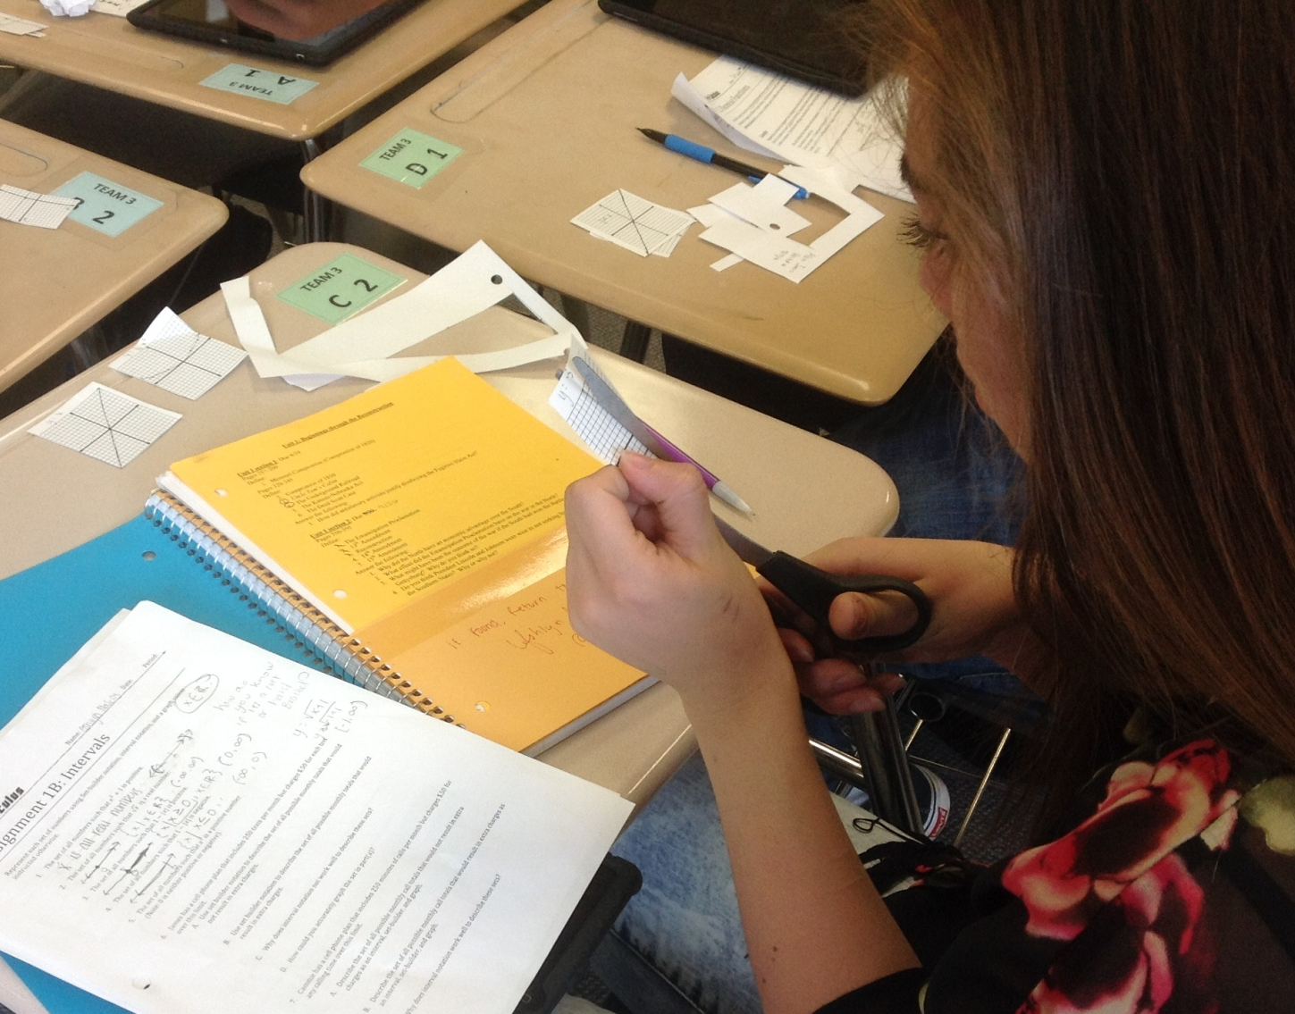
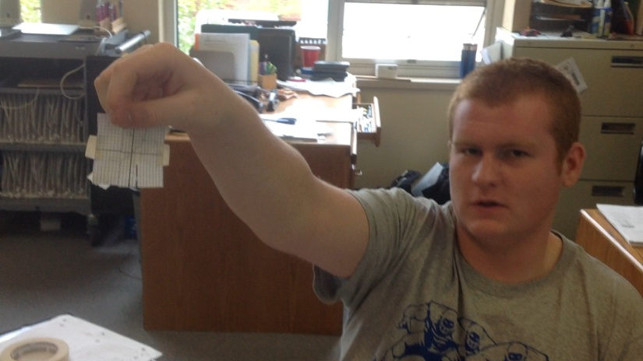
Piecing it together
Ω

Slide 11
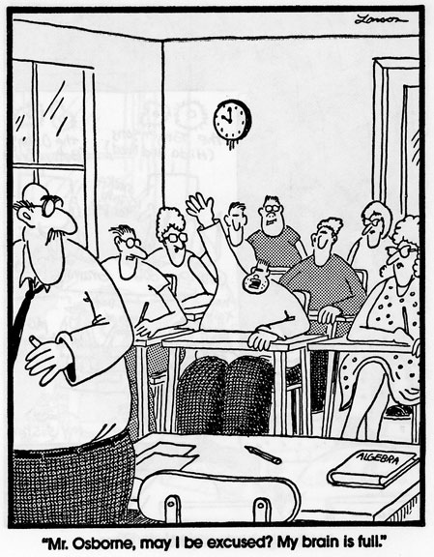
What if They Still Don’t Learn?
Ω
Notes:
What if they don’t buy into “real life application”

Slide 12
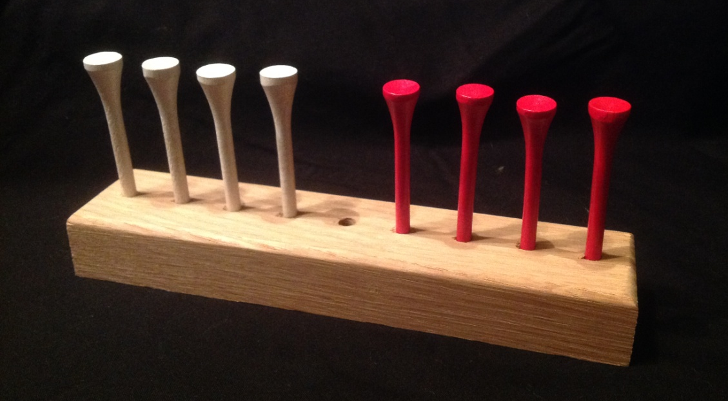
Patterns and Expressions
Option 1:
Option 2:
What’s the minimum number of moves?
Ω

Slide 13
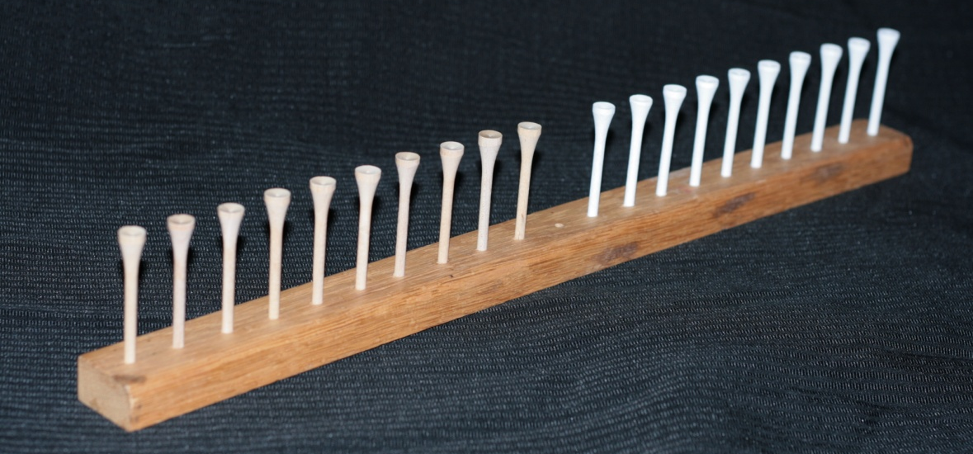
Applying Algebra
Pegs | Moves
1 | 3
2 | 8
3 | 15
4 | 24
… | …
n | (n+1)²
Ω

Slide 14
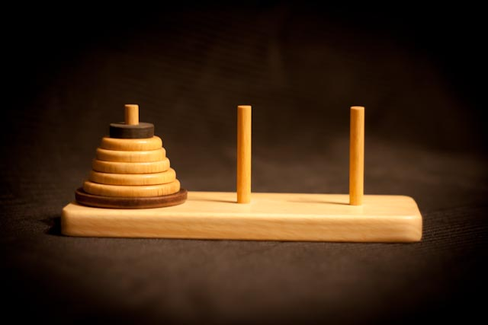
Exponential Growth & The Tower of Hanoi
What’s the minimum number of moves to solve this puzzle?
Ω

Slide 15
Break it Down
Discs | 1 | 2 | 3 | 4 | 5 | … | n
Moves | 1 | 3 | 7 | 15 | 31 | … | 2 ^{n} -1
Ω

Slide 16
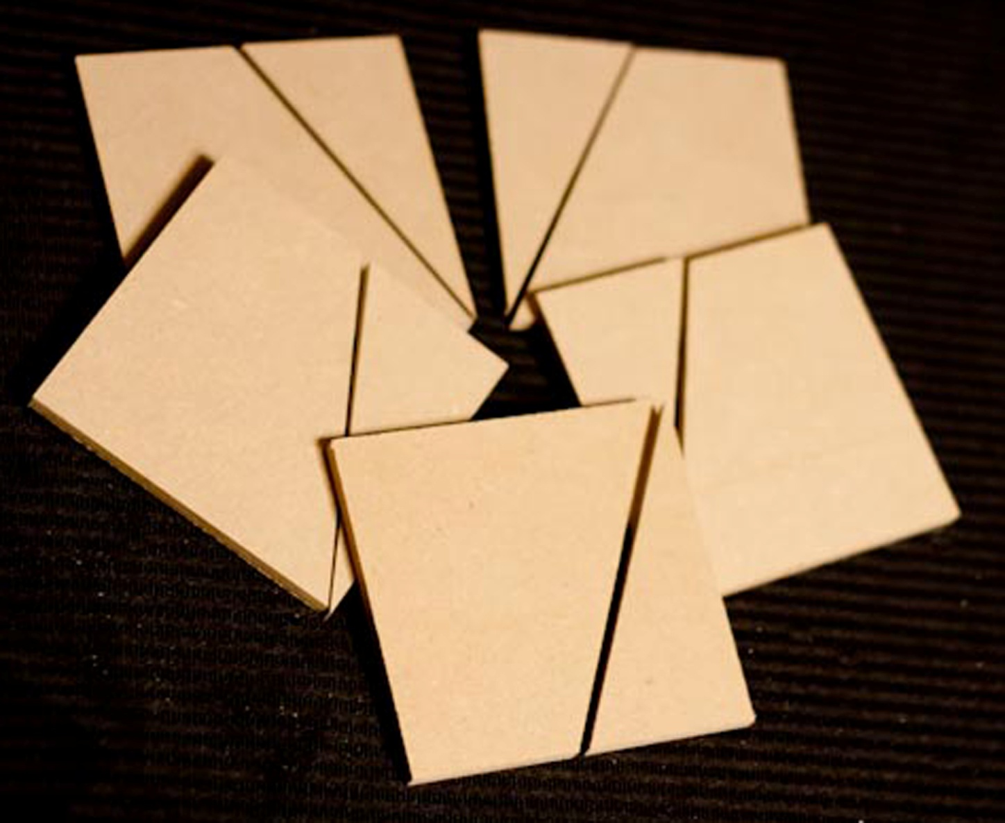
Why is $\sqrt{20}=2\sqrt{5}$?
Five Square Puzzle
Can you make One large square?
Ω

Slide 17
What is a Square Root?
Ω

Slide 18
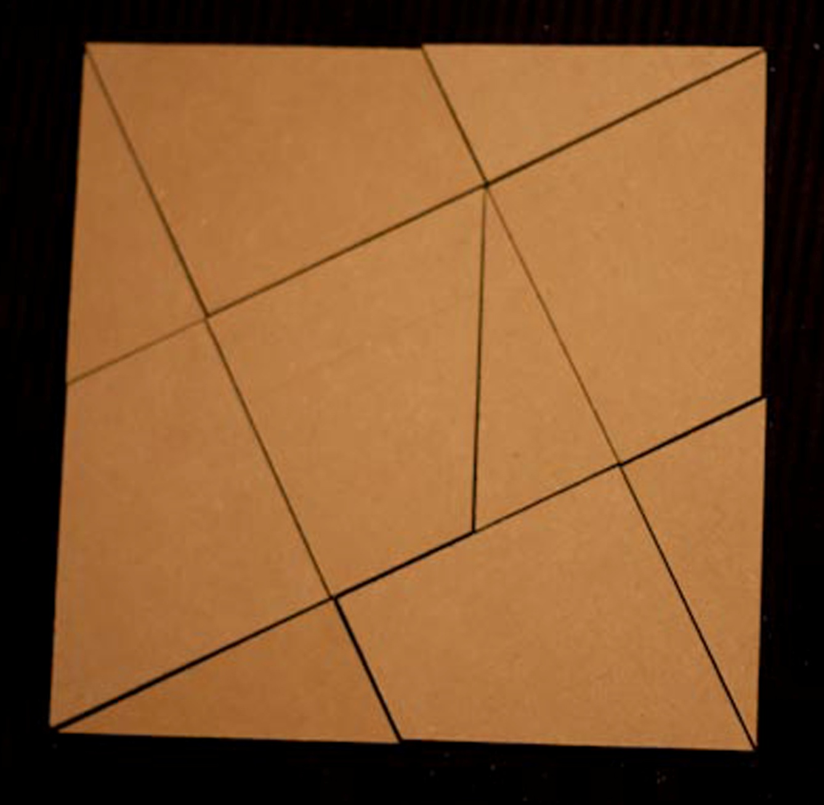
The Root is the Length
Ω

Slide 19
It takes time… & It’s worth it!
Give students time to get their hands on the Math!
Ask Yourself: When can I use this in my life?
Ω

Slide 20
Title
More Details at: www.knightmath.com/ignite
Video Credit: Kids Snippets by Bored Shorts TV
Ω

